Slide 1
Shopping in Istanbul
Analytical project by Nataliia Shevchenko
March 2024

Slide 2
Data sources
Customer Shopping Dataset - Retail Sales Data - https://www.kaggle.com/datasets/mehmettahiraslan/customer-shopping-dataset - Exploring Market Basket Analysis in Istanbul Retail Data. 100k records of retail sales activity in 8 shopping malls in Istanbul in 2021, 2022 and 2023
OpenExchangeRates API - https://docs.openexchangerates.org - historical currency exchange rates of Turkish lira to US dollar. Used to account for inflation in Turkey in 2021, 2022 and 2023
Visual Crossing Weather API - https://www.visualcrossing.com - historical weather in Istanbul in 2021, 2022 and 2023

Slide 3
Project structure
Sources
Kaggle
OpenExchangeRates API
Visual Crossing Weather API
Manual download
Customer shopping dataset
Resources\source\customer_shopping_data.csv
CurrencyExchangeAPI.ipynb
Ingestion of historical currency exchange rates
Resources\output\ exchange_rate.csv
WeatherAPI.ipynb
Ingestion of historical weather
Resources\output\ Istanbul_historical_weather.csv
Ingestion
DataDiscovery.ipynb
Initial data discovery on raw shopping data
DataPreparation.ipynb
Merging customer shopping dataset with historical currency exchange rates and weather; calculating cost metrics in USD; adding age buckets and calendar columns; renaming and reordering
Resources\output\customer_shopping_data.csv
Processing
DataAnalytics.ipynb
Common dependencies; Shopping malls traffic; Dependency on weather conditions; Average weather conditions over year; Seasonal changes of average price and total cost for different categories
Analysis
Technology stack:
Python: pandas, matplotlib, scipy.stats, requests
Jupyter Notebook (IronPython), REST API, CSV

Slide 4
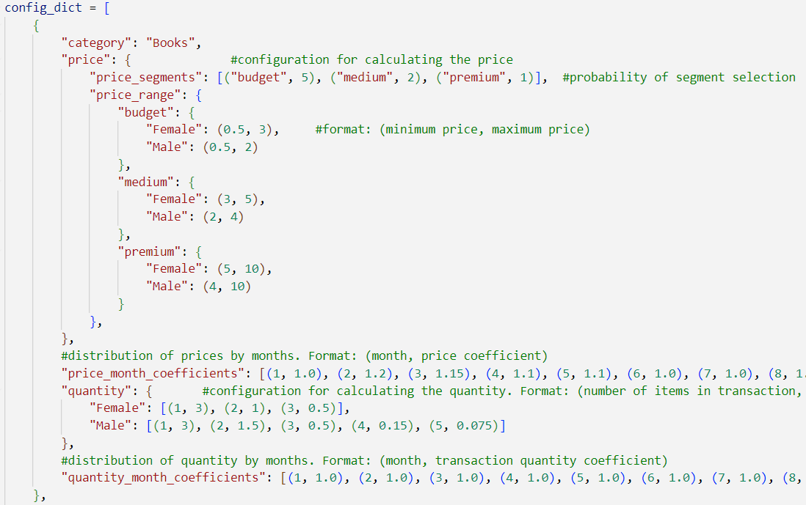
Random Data Generation
Key features:
Random generation of price (total price of a transaction) and quantity
Price can be configured at category, price segment, gender and month level
Quantity can be configured at category, gender and month level
Configuration allows to embed multiple patterns into the retail data that can be leveraged for different kind of analytics

Slide 5
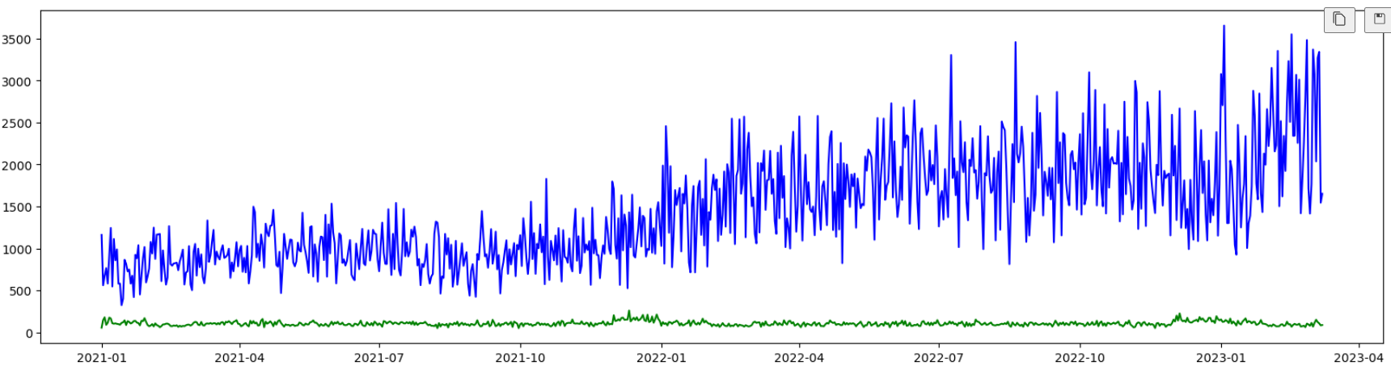
Data Discovery
Main observations:
There are only 100k records to analyze, each record has unique invoice_no and unique customer_id, so there are no opportunities for neither basket analysis nor customer behavior over time analysis
Date is presented from 1/1/2021 till 3/8/2023, total 797 days
Total quantity per day shows seasonal peaks, while average daily price shows big inflation and seasonal peaks
There is 60:40 ratio for women’s and men’s transactions for a whole data set
There are only 8 categories of products and only 10 shopping malls to analyze

Slide 6
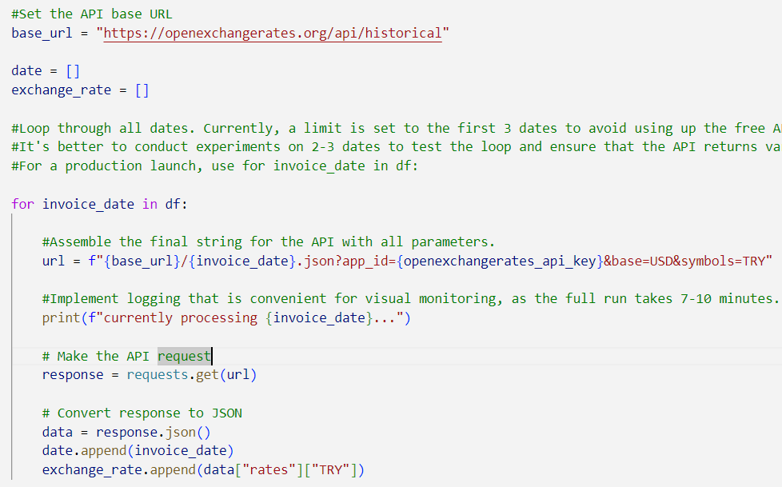
Currency Exchange API
Key features:
Using a loop across unique days only to limit a number of API requests
Date format conversion from DD/MM/YYYY to YYYY-MM-DD to meet API format
Saving result to CSV file

Slide 7
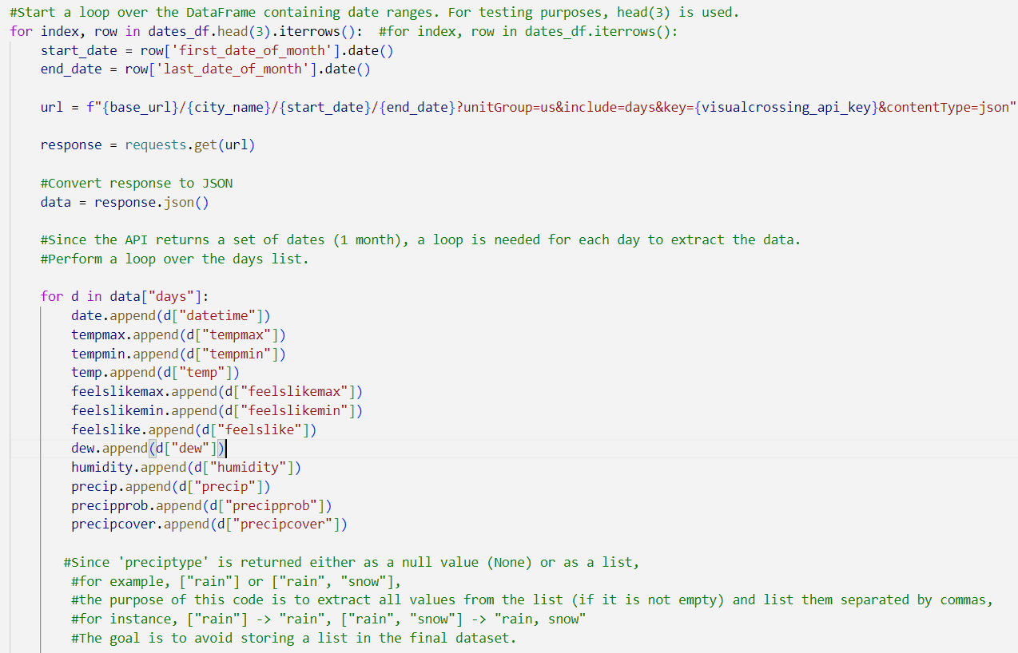
Weather API
Key features:
Using a loop across unique monthly ranges only to limit a number of API requests
Additional parsing of the response to retrieve daily data
Additional parsing of lists to have a fully flat final structure
Date format conversion from DD/MM/YYYY to YYYY-MM-DD to meet API format
Saving result to CSV file

Slide 8
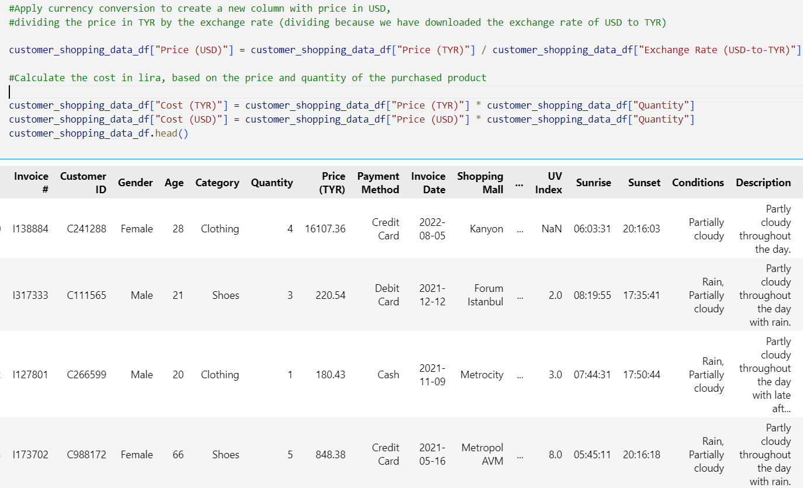
Data Preparation
Key features:
Merge with exchange rates to consider inflation by converting to USD
Merge with historical weather in Istanbul
Calculating two types of age buckets
Calculating calendar columns for seasonal analytics and year-over-year comparison
Renaming and reordering
Saving result to CSV file

Slide 9
Data Analytics
Key features:
Utilizing a prepared CSV file minimizes additional data transformations, enhancing performance and reducing memory usage. Selecting only necessary columns from the dataset further optimizes memory consumption
Applying the following statistical tests:
ANOVA test is applied for comparing metrics distribution across different attribute values, replacing T-tests for two groups
Chi-square test is employed to analyze mall traffic distribution by gender
Correlation coefficients are calculated for time-series analysis
Custom data visualization functions, namely metrics_distribution_by_attribute and time_series_plots, are utilized to simplify development and prioritize data analysis
The pivot_table() method of DataFrame is utilized to compute year-over-year weather conditions distribution, with stacked bar charts used to identify months with specific weather conditions
Analysis encompasses various combinations of product categories and attributes, with focus on the most relevant findings included in the final analysis file

Slide 10
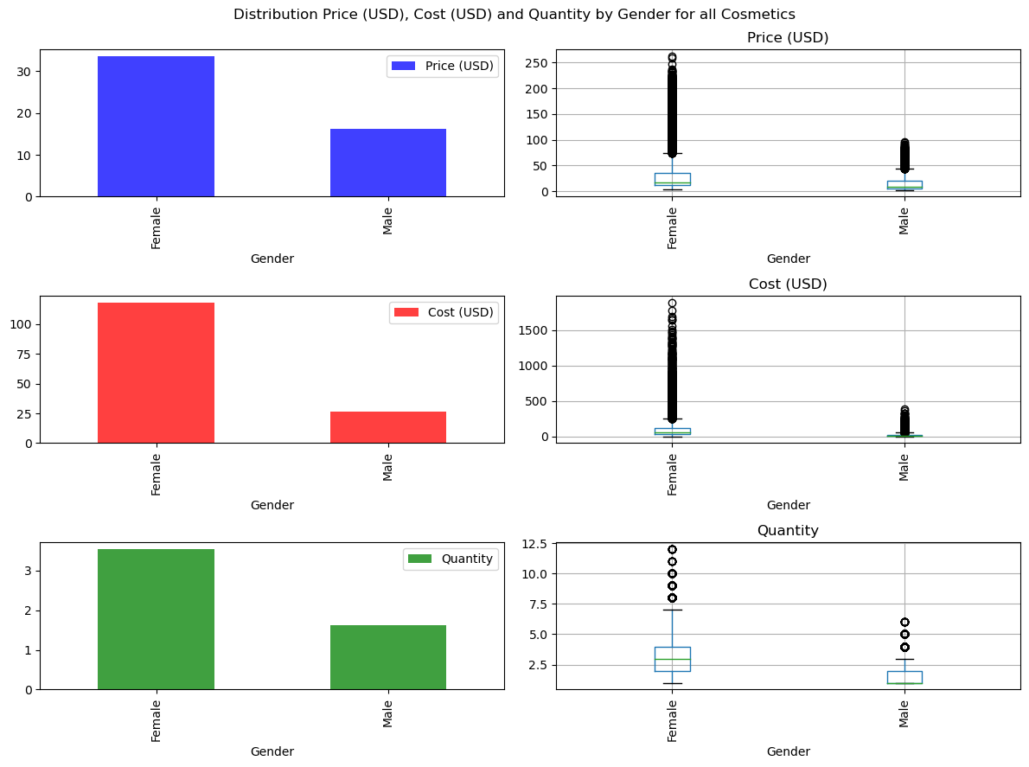
Advanced Statistics. Sales Patterns By Gender
Key metrics of ANOVA test:
p-value = 1.637e-200
There are statistically significant differences in the distribution of Avg Price (USD) by Gender.
p-value = 0.0
There are statistically significant differences in the distribution of Avg Cost (USD) by Gender.
p-value = 0.0
There are statistically significant differences in the distribution of Avg Quantity by Gender.
The most interesting common dependencies found (based on comparison of average values of price, cost and quantity):
On average, women purchase more cosmetics than men across price, cost, and quantity metrics.
Within the Clothing category, individuals aged 35-50 tend to buy more expensive products, while maintaining similar purchase quantities.
On average, women buy more souvenirs than men, with prices remaining consistent between the two genders

Slide 11
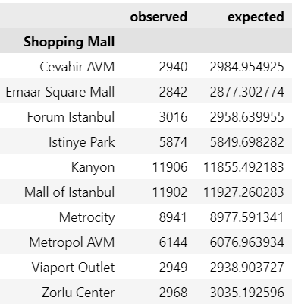
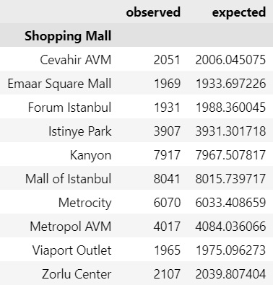
Advanced Statistics. Shopping Mall Traffic
Female traffic
Male traffic
Key metrics of chi-square test:
Female traffic
Critical value = 16.918
statistic=5.002, pvalue=0.834
p-value > 0.05, we cannot reject H0; therefore, the difference in women’s shopping mall traffic is random.
Male traffic
Critical value = 16.918
statistic=7.444, pvalue=0.591
p-value > 0.05, we cannot reject H0; therefore, the difference in men’s shopping mall traffic is random.
Analysis (based on total traffic – number of visitors):
Utilizing the common 60:40 ratio of women to men, expected traffic can be calculated for shopping malls
Chi-square test helps identify if there are preferences among women or men for specific shopping malls
The analysis indicates that neither gender exhibits a preference for particular shopping malls, suggesting equal patronage across locations

Slide 12
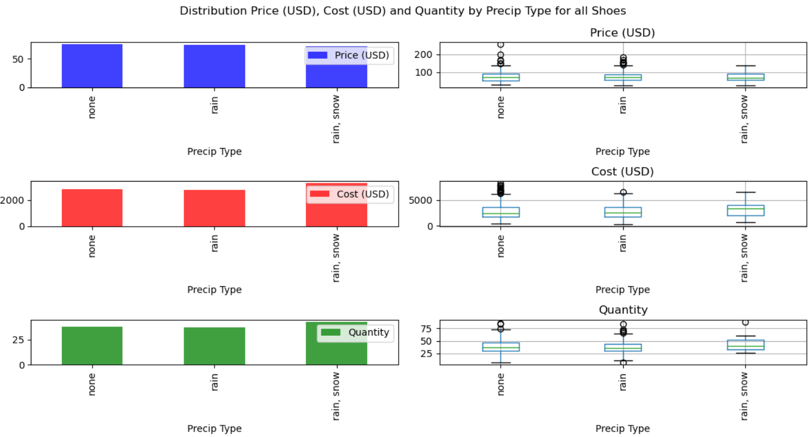
Advanced Statistics. Sales Dependency On Weather
Key metrics of ANOVA test :
p-value = 0.866
There are no statistically significant differences in the distribution of Price (USD) by Precip Type.
p-value = 0.143
There are no statistically significant differences in the distribution of Cost (USD) by Precip Type.
p-value = 0.035
There are statistically significant differences in the distribution of Quantity by Precip Type.
Analysis (based on comparison of average values of price, cost and quantity):
Shoe sales typically increase on rainy or snowy days compared to days with no precipitation.
This trend is confirmed distribution of price, cost, and quantity by weather conditions and having snow days
This suggests a higher demand for winter footwear during rain/snow weather, prompting quicker purchases

Slide 13
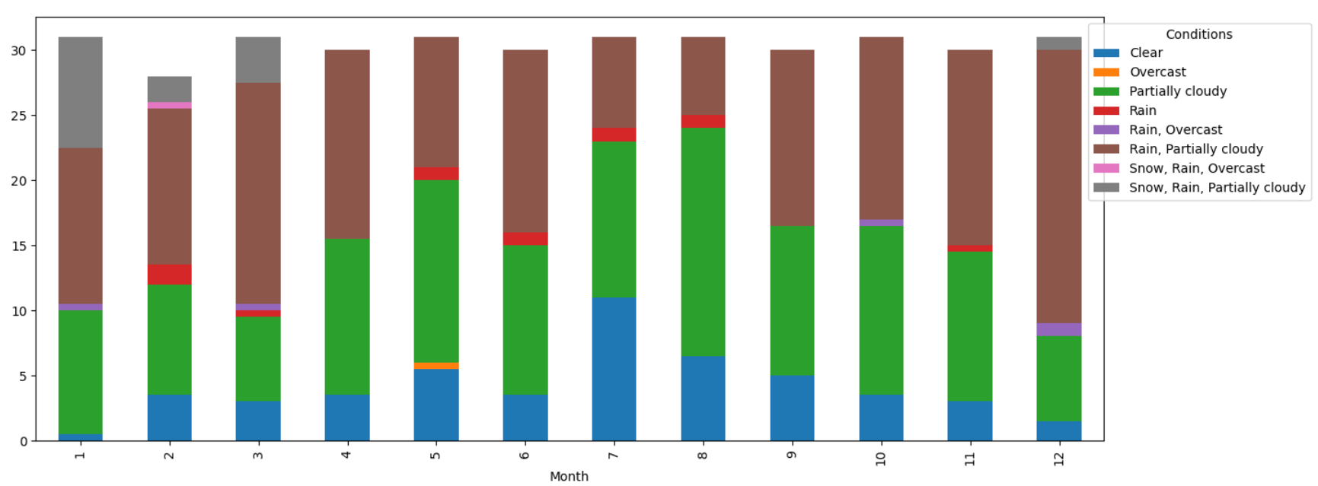
Data Analytics. Weather Conditions By Month
Analysis:
Snow and rain weather conditions are primarily experienced during January, February, and March, with occasional occurrences in December as well. Consequently, this presents an opportunity for manufacturers and shopping malls to strategically plan marketing campaigns for shoe sales during these months, capitalizing on consumer needs driven by inclement weather..

Slide 14
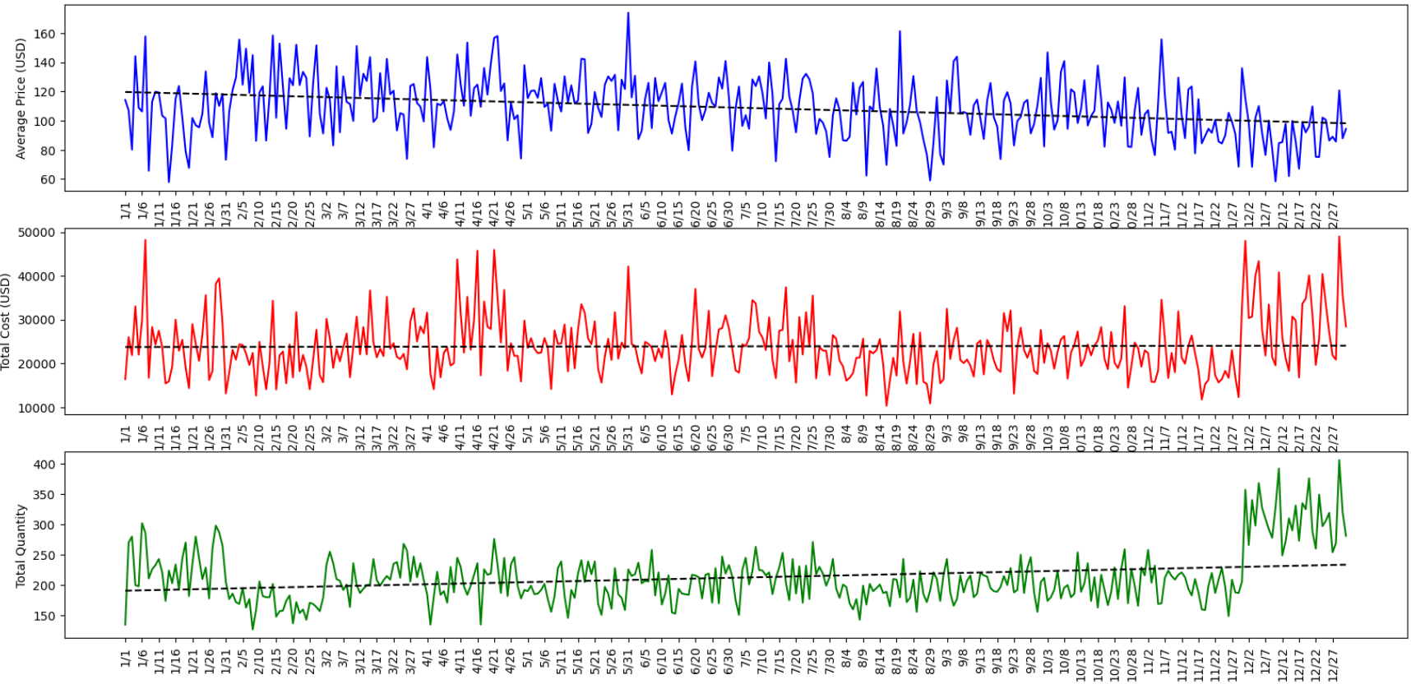
Data Analytics. Seasonal Changes For Clothing
Analysis:
Towards the end of the year, prices show a tendency to decrease, potentially indicating the influence of the December sales season
Additionally, notable peaks in both total daily cost and quantity occur in December. This phenomenon suggests the effectiveness of marketing strategies implemented during this period

Slide 15
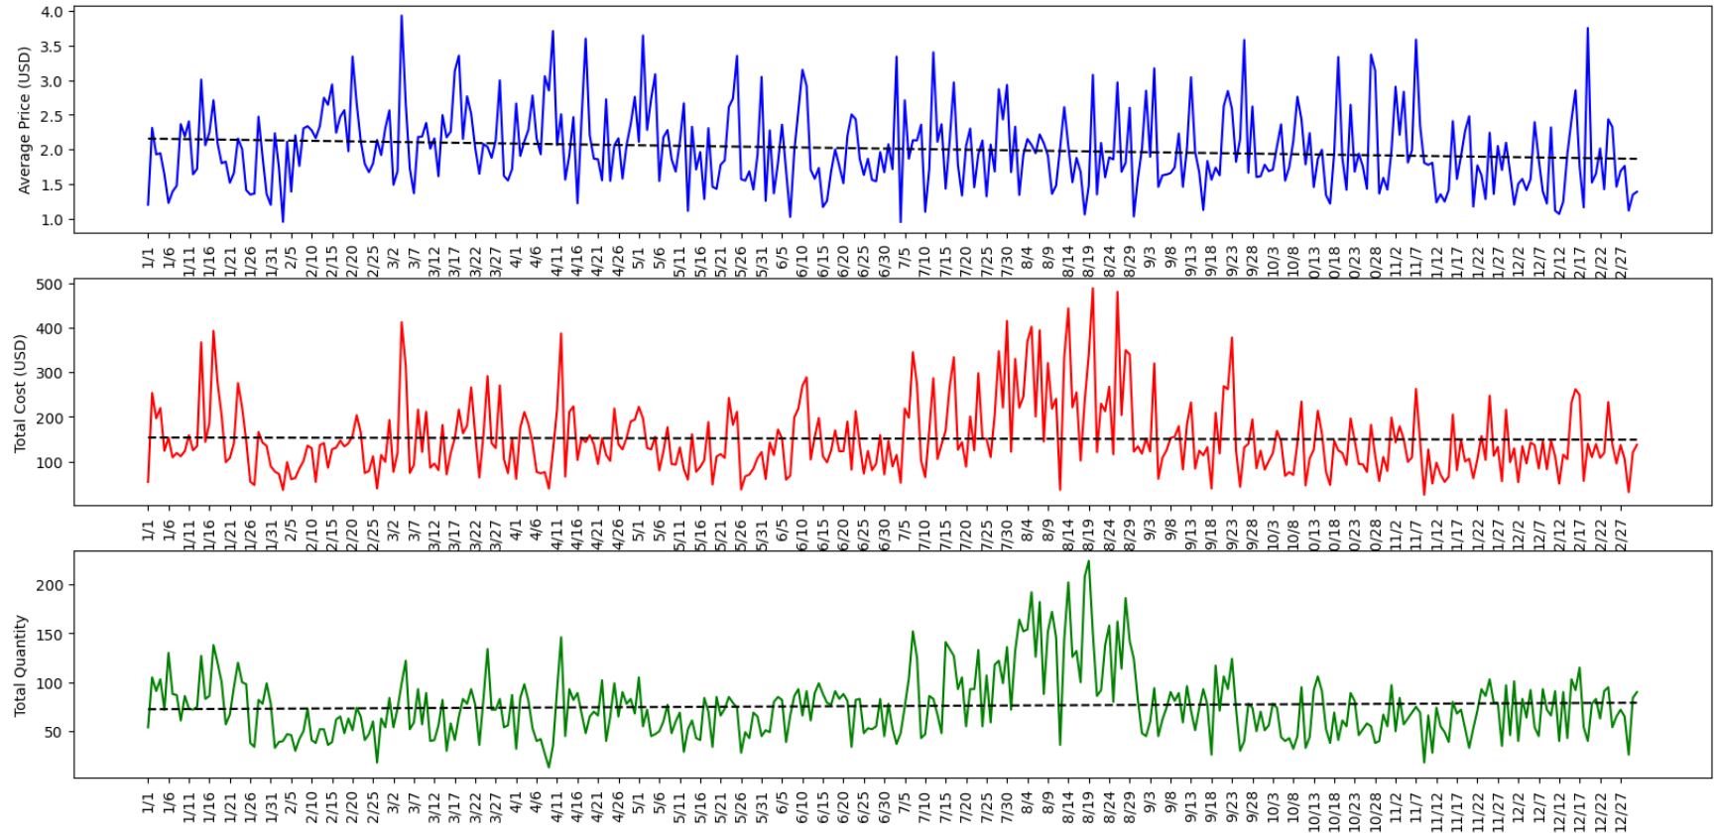
Data Analytics. Seasonal Changes For Souvenirs
Analysis:
Price exhibits no discernible trends throughout the year
However, there are noticeable peaks in both total daily cost and quantity during July and August, particularly pronounced in August. This observation suggests a seasonal trend, likely attributable to increased tourism during these months

Slide 16
Conclusions
Analytical insights:
When dealing with foreign currencies, it's crucial to account for inflation. Converting to USD is a common approach to address this concern
Remaining open to various hypotheses about the data and investigating any discovered dependencies is essential for validation and uncovering underlying reasons
In searching for seasonal trends, it is advisable to analyze complete years of data to prevent biased results
Key Takeaways:
Stage data ingested from APIs to avoid excessive API calls. Limiting API calls, especially to unique dates, is vital for both restricted and paid pricing plans. Whenever possible, retrieve data once and reuse it across multiple analyses to optimize resource usage
Separate data ingestion and data transformations from data discovery and analytics to maintain logical separation and streamline team development processes
Utilize functions for repetitive tasks to enhance analytical performance. By implementing complex functions, we can reduce the amount of code needed to call them. In this project, only two lines of code were required to invoke functions that generate charts and conduct statistical analyses for multiple metrics simultaneously. This approach enables efficient analysis across numerous combinations, allowing focus on identified dependencies

Slide 17
Random Data Generation
Key features:
Random generation of price (total price of a transaction) and quantity
Price can be configured at category, price segment, gender and month level
Quantity can be configured at category, gender and month level
Configuration allows to embed multiple patterns into the retail data that can be leveraged for different kind of analytics

Slide 18
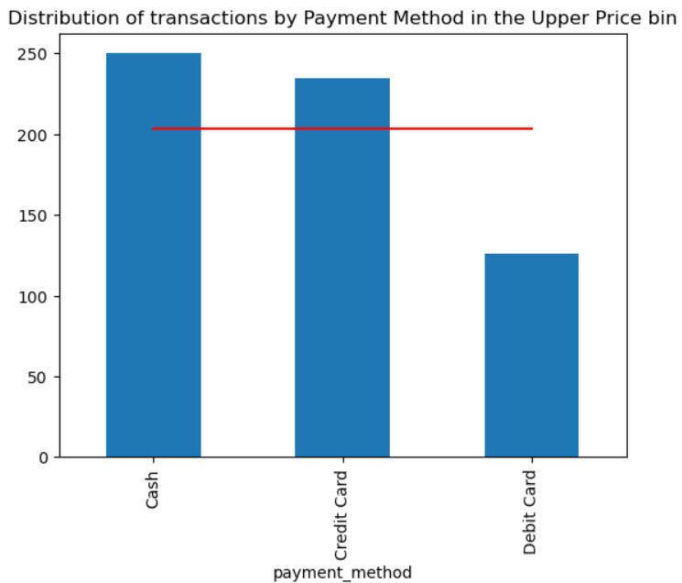
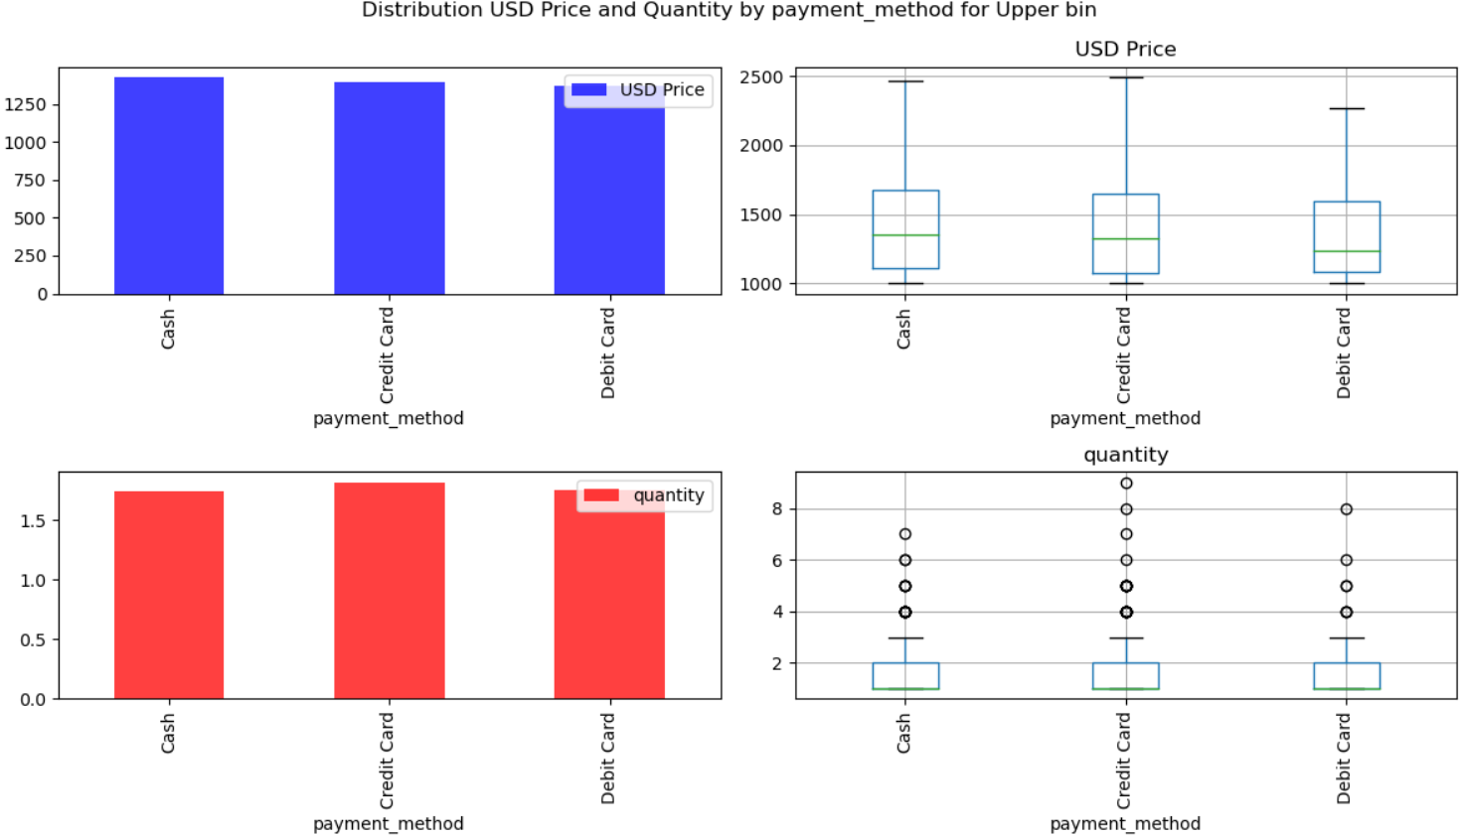
Data Analytics. Preferable payment methods
Analysis:
Distribution of payment methods in upper and lower pricing bins are almost the same: Cash is the most and Debit card is the least preferable payment methods, confirmed by Chi-square test
In both upper and lower pricing bins there are no dependency between price and quantity of an average transaction and a payment method. Confirmed by ANOVA test

Slide 19
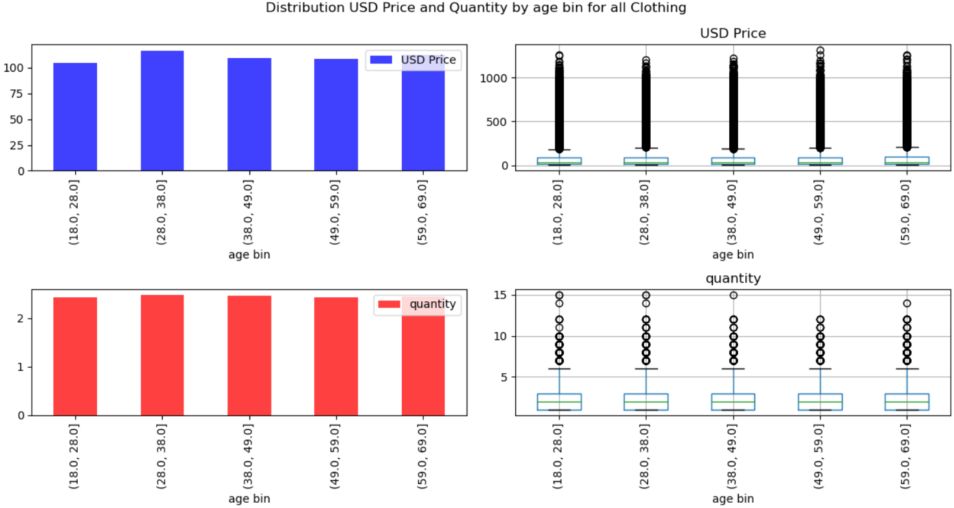
Data Analytics. Shopping preference by age group
Analysis (all confirmed by ANOVA test):
In the common case there is no dependency between price and quantity of an average transaction and age
For the Clothing category average price in the age group 28-38 is statistically higher than for other age groups. Therefore, customers in the age group 28-38 prefer more expensive clothing

Slide 20
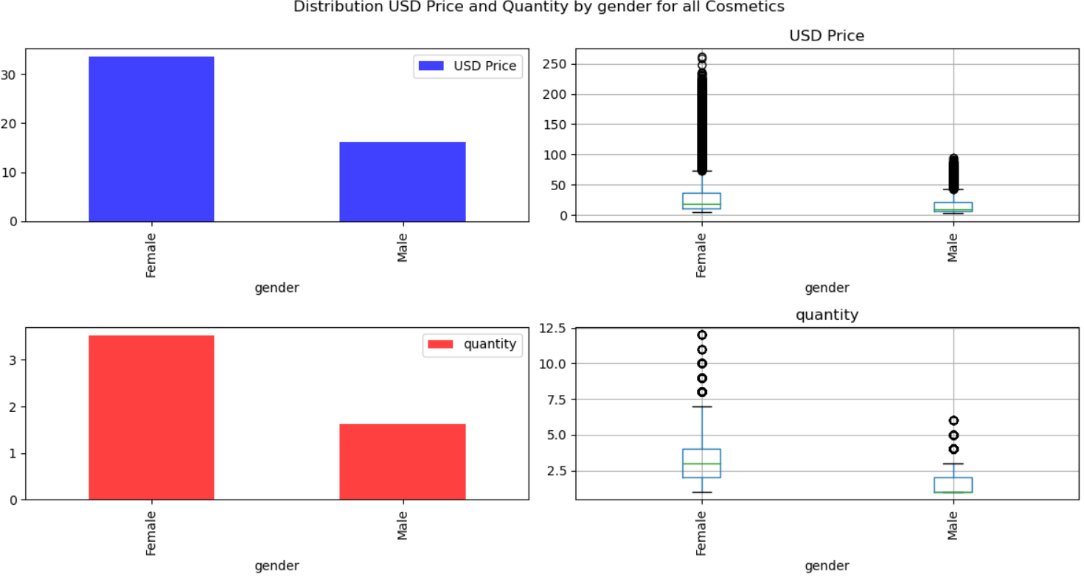
Data Analytics. Shopping preference by gender
Analysis (all confirmed by ANOVA test):
For most of categories there is a dependency between price and quantity of an average transaction and age
In Cosmetics category both price and quantity in an average transaction is higher for women than for men
In Souvenir category women buy more souvenirs than men, but their souvenirs are less expensive

Slide 21
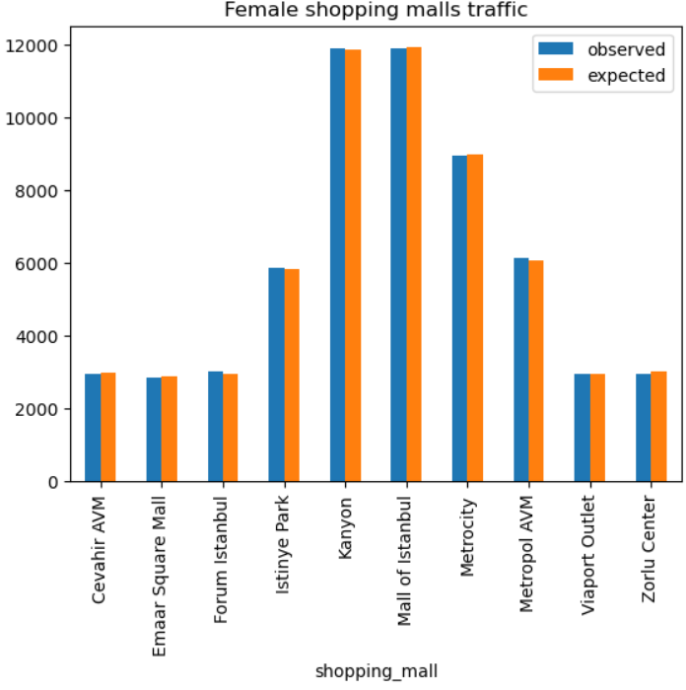
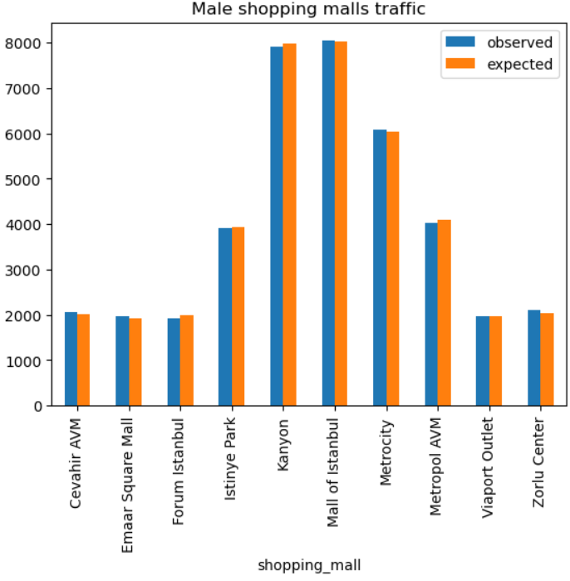
Data Analytics. Shopping malls traffic
Analysis:
Checked the hypothesis that female and male traffic for some shopping malls is different from a common distribution of 60:40 female:male transactions
Chi-square test shows that there are no preferable shopping malls neither for women nor for men

Slide 22
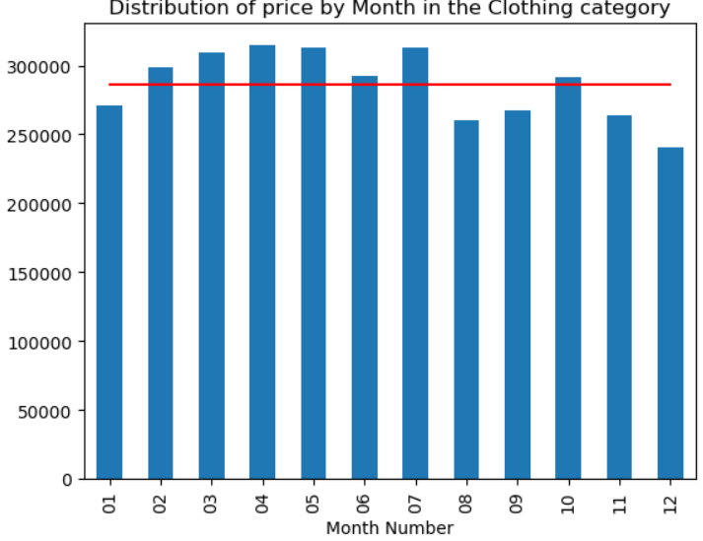
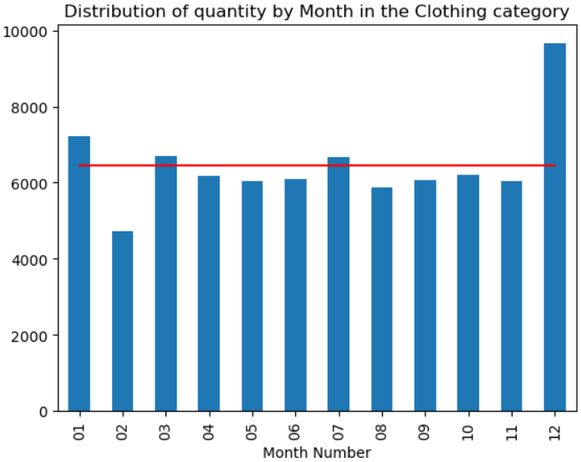
Data Analytics. Seasonal variance analysis
Analysis:
Chi-square test confirmed that for all categories there are statistically significant differences both in total price and total quantity between different months
For all categories December shows less than average total prices, but greater than average total quantities that can be explained by sales season, while February usually shows less than average activity of customers. For Souvenirs the peak month is August that can be explained by a touristic season

Slide 23
Questions

